Slide 1
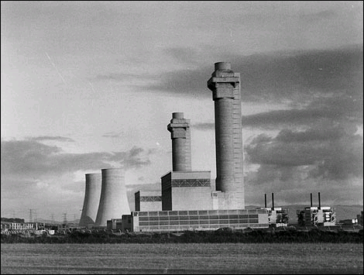


Slide 2

In October 1957, a fire occurred in a plutonium production reactor at the Windscale site on the coast in the northwest of England.
“It is the most serious nuclear accident in UK history (Taylor 2007, p.15)”

Slide 3
During a routing heating operation used to release the potential energy stored in the graphite, regions of high local heating caused the graphite to burn and ignite the cladding, thereby exposing the uranium to air.

Slide 4
The Windscale nuclear facility now known as Sellafield in the UK, built in the late 1940s to produce radioactive material for atomic weapons (Ropeik & Gray 2002, p.260).
On October 7, 1957, the reactor was shut down for a routine maintenance operation, which was aimed at releasing the stored ‘Wigner’ energy deposited in the graphite by atomic displacement (Collier & Hewitt 1987, p.139).
At 6:45pm on October 10, 1957, there was an obvious glow from the core of the Windscale reactor and approximately after two hours, yellow flames appeared.

Slide 5
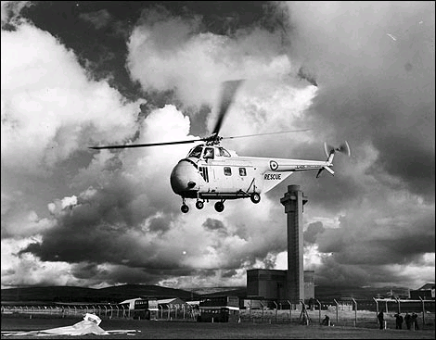
Highly radioactive fission products poured out of the reactor’s 22 metre high chimney and spread across the English countryside.
Firemen first tried to put out the fire by pumping carbon dioxide gas, but this made the flames ever worse.
Vast amounts of water were pumped into the reactor producing huge cloud of highly radioactive steam and smoke was released into the atmosphere
Source: Holdstock & Barnaby (2003, p.5).

Slide 6
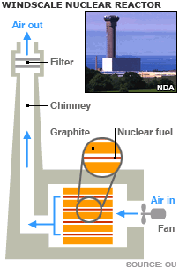
The origin of the accident lay in a peculiar type damage induced by neutrons in graphite.
The increase in heat permits the release of energy stored in the graphite.
Some part of the Windscale reactor cooling was not adequate that the graphite became hot and the uranium fuel elements began to burn.
The fire was subsequently transferred to the nearby graphite.

Slide 7
Faulty move by an operator, where he applied nuclear heating too rapidly, caused a fuel cartridge to split, releasing its contents, which then oxidized in the air, igniting the graphite moderator which burned furiously for two days.
The ‘Wigner’ energy was to be released slowly at frequent intervals but the operator failed to do so (Morgan & Peterson 1999, p.76)

Slide 8
The fire at first smouldered, but by October 10, 1957, it was an inferno engulfing some 150 fuel channels with both uranium and graphite on fire.
At the height of the blaze, some 11 tones of uranium were burning (Newtan 2007, p.116).

Slide 9
As first the Windscale staff hesitated to use water to quell the fire since this could generate explosive hydrogen gas from the interaction of very hot metal or molten uranium and water.
Therefore, carbon dioxide was first tried but this actually intensified the fire due to the oxygen released from the CO₂.
The fire was extinguished on the fifth day by flooding the reactor with water, and the whole reactor system was then sealed off (Draganic & Draganic 1993, p.271).

Slide 10
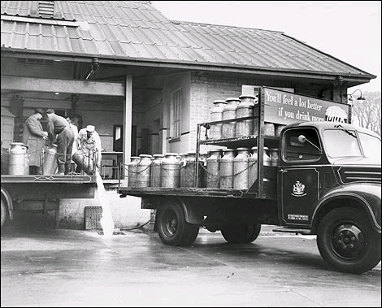
The fire caused large-scale release of radioactivity, 200,000 curies of radioactive iodine.
Consequently, the sale of all milk in a 450 square kilometre area was banned (Ursano, Norwood, & Fullerton p.179).
The village of Seascale has had four fatal leukaemia cases in children who were under 20 years of age between 1950 and 1980 (Hayes 2001, p.703).
Pouring away milk at the Milk Marketing Board in Egremont, 15th October 1957. Hundreds of farms in south and west Cumbria were told to pour their milk away after radiation was released during the fire.
– Source- BBC UK

Slide 11
It is estimated that the large amount of iodine released into the atmosphere would have caused some 260 thyroid cancers in the exposed population.
An area about 200 square miles around the plant of which about 13 would be fatal.
The accident also released 240 curies of the uranium daughter isotope polonium and it is estimated that his exposure may have caused up to 33 people to develop other cancers.
The Windscale accident was environmentally significant. (Adelson et al. 2008, p.89).

Slide 12
The British National Radiological Protection Board said in 1987 that the accident is likely to contribute to 33 premature cancer deaths over the lifetimes of the several hundred thousand people exposed to the radiation Ropeik & Gray (2002, p.260).
One of the lessons learned is that inadequacies in reactor instrumentation and reactor operator can lead to large-scale accident.
There was a certain mistrust of instrumentation during the course of the incident thus effective temperature measurement is required.

Slide 13
The British National Radiological Protection Board said in 1987 that the accident is likely to contribute to 33 premature cancer deaths over the lifetimes of the several hundred thousand people exposed to the radiation Ropeik & Gray (2002, p.260).
There was practically no information published regarding safe levels of Iodine-131 in milk at the time of the incident which was very important to ensure people’s safety.
The potential harm from the release of fission products is an increase in the risk that already exists from natural causes of development of thyroid carcinoma, lung cancer, or leukaemia.
The escape of some fission products will tell us that there is a need to review nuclear reactor safety designs.

Slide 14
The Windscale nuclear reactor was fuelled by natural uranium, graphite-moderated, and air cooled.
The incident happened because of the damage induced by neutrons in graphite. The graphite became hot causing the uranium fuel elements to burn.
The fire spread to the nearby graphite and large amount of fission products were released into the environment.
Firemen controlled the fire by flooding the reactor with water.

Slide 15
Adelson G. et al., 2008. Environment: an interdisciplinary anthology. Yale University Press, US
Collier J. & Hewitt G. F. 1987. Introduction to Nuclear Power. Taylor & Francis, US
Draganić I G. & Draganić Z. D. 1993. Radiation and radioactivity on earth and beyond. CRC Press, US
Hayes A. W. 2001. Principles and methods of toxicology. CRC Press, US
Holdstock D. & Barnaby Frank. 2003. The British nuclear weapons programme, 1952-2002. Taylor & Francis, UK
Morgan K. Z. & Peterson K. M. 1999. The angry genie: one man's walk through the nuclear age. University of Oklahoma Press, US
Newtan S. U. 2007. Nuclear War I and Other Major Nuclear Disasters of the 20th Century. AuthorHouse, US
Ropeik D. & Gray G. M. 2002. Risk: a practical guide for deciding what's really safe and what's dangerous in the world around you. Houghton Mifflin Harcourt, US
Taylor S. 2007. Privatisation and financial collapse in the nuclear industry: the origins and causes of the British energy crisis of 2002. Routledge, US
Ursano R J., Norwood A. E., & Fullerton C. S. 2004. Bioterrorism: Psychological and Public Health Interventions. Cambridge University Press, UK

